Slide 1
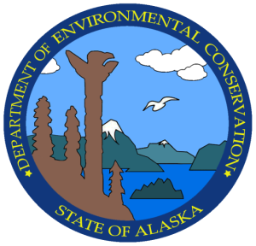
Alaska Department of Environmental Conservation
Conserving, improving and protecting Alaska’s Natural resources and environment to enhance the health, safety, economic and social well-being of Alaskans
Alaska Department of Environmental Conservation

Slide 2
ADEC Divisions & Programs
Air Quality – outdoor air pollution
Spill Prevention & Response
  Prevention Preparedness & Response – protects public health, safety and the environment by preventing and mitigating the effects of oil and hazardous substance releases and ensuring their cleanup
  Contaminated Sites

Slide 3
More Divisions & Programs
Water Quality
  Wastewater Discharge Authorization
  Water and Wastewater Operator Certification
  Water Quality Standards, Assessment & Restoration
  Cruise Ships
  Village Safe Water
Environmental Health
  Drinking Water
  Solid Waste
  Food Safety and Sanitation
  State Veterinarian

Slide 4
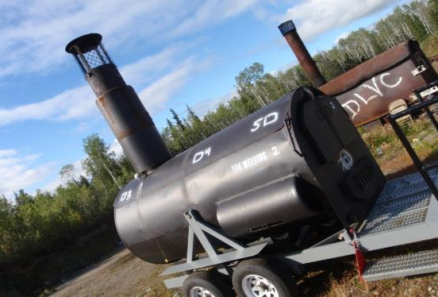
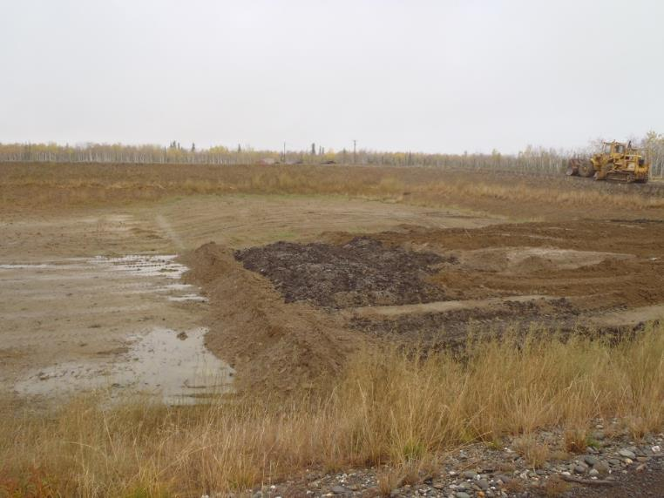
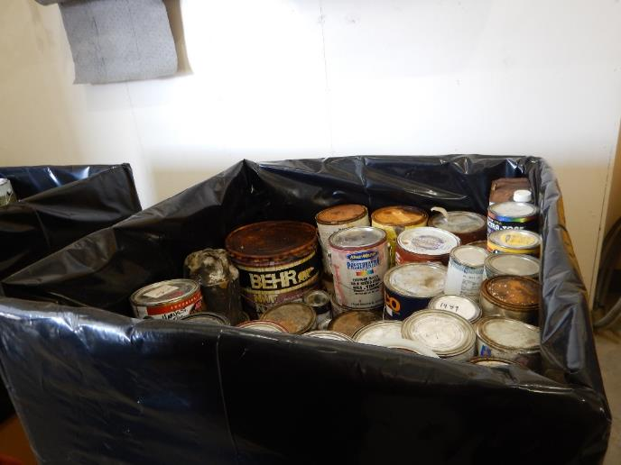
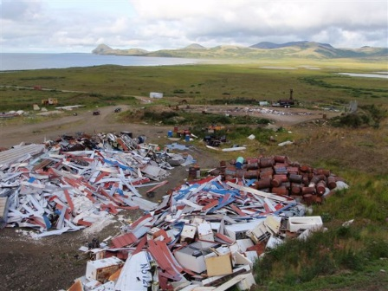
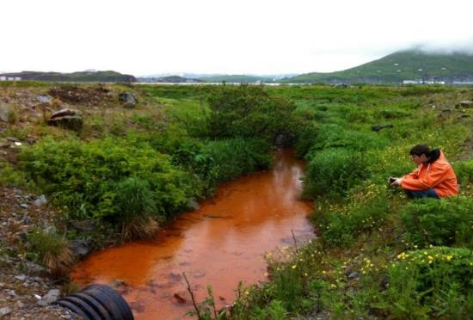
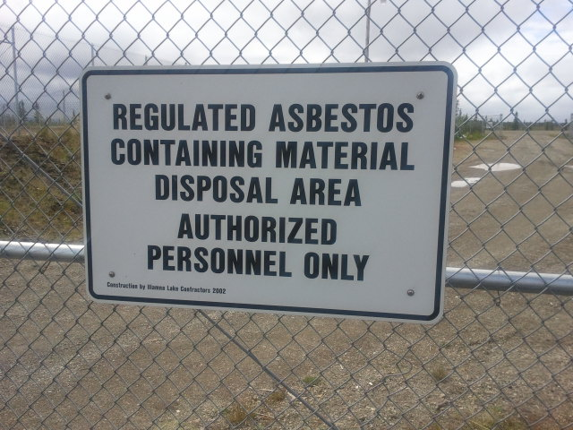
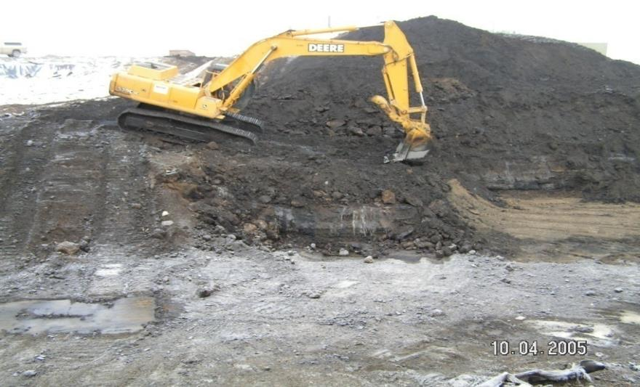
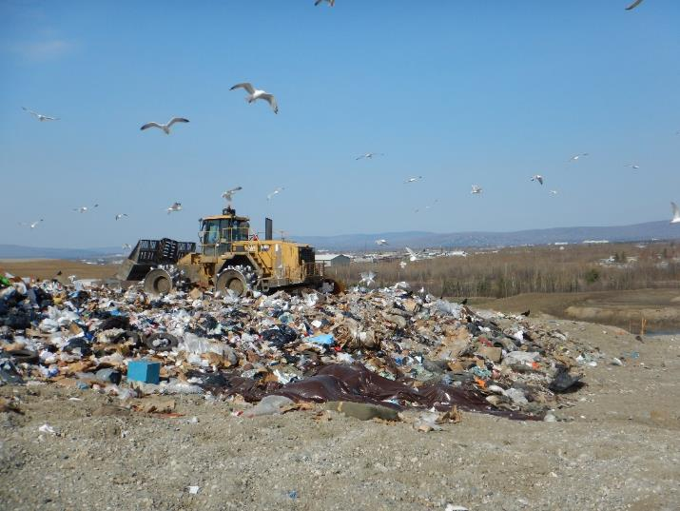
The World of Solid Waste in Rural Alaska

Slide 5
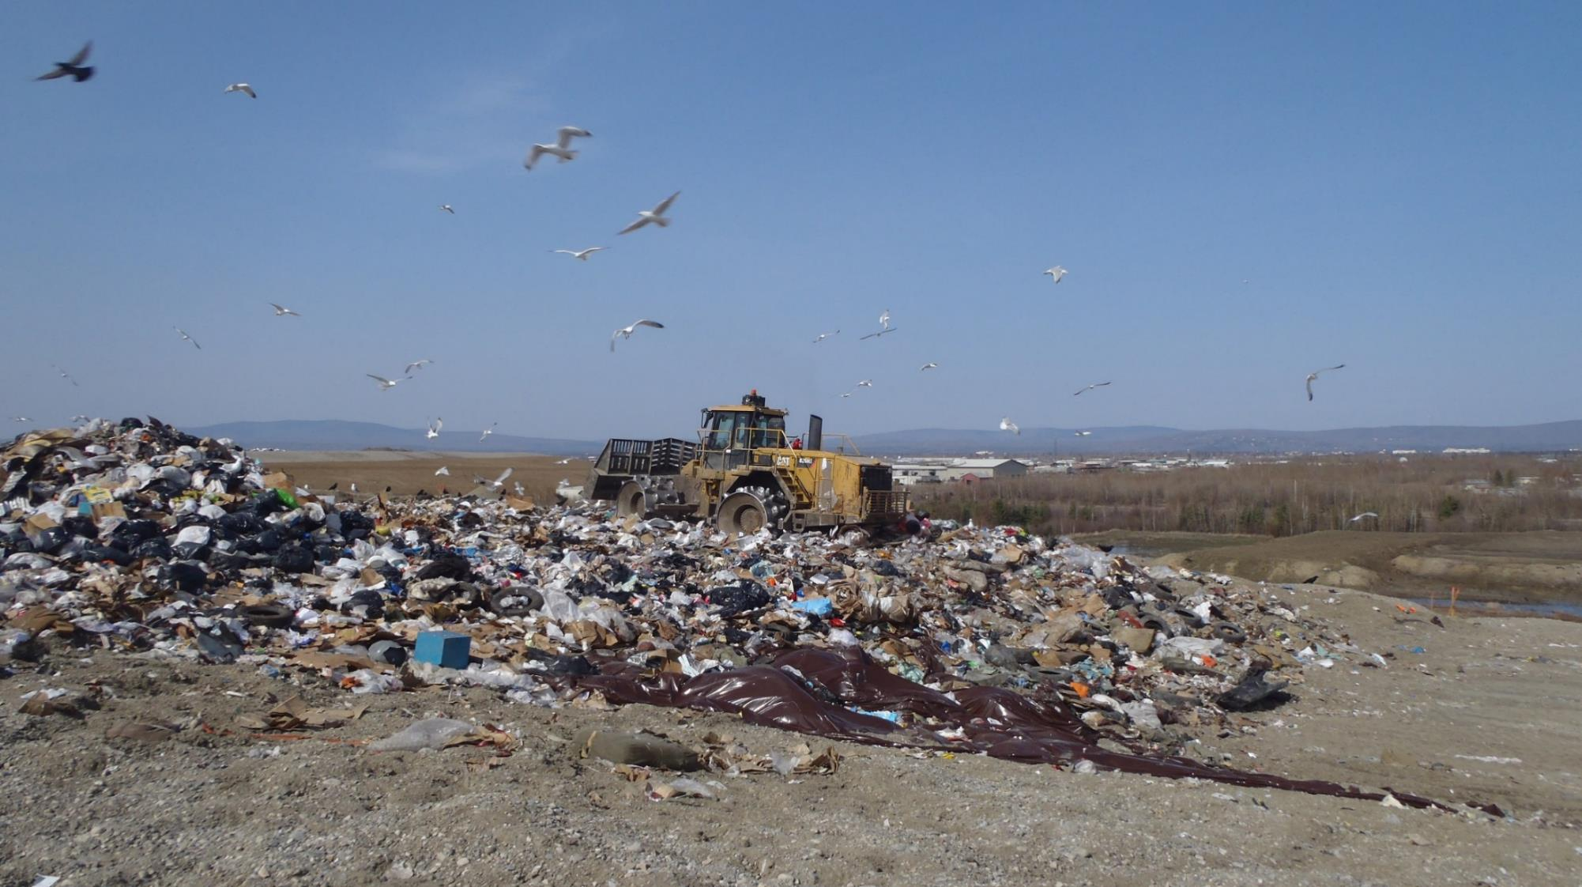
Alaska Department of Environmental Conservation Solid Waste Program
In a normal day we work with;
Landfills-Monitoring, Permitting, Operations, Technical Assistance
Regulatory Compliance of Alaska Solid Waste Regulations
Recycling-Programs and Logistics
Backhaul-Programs and Logistics
Trash related questions and complaints
Community Outreach and Education to improve solid waste management
Use multiple sciences and engineering on a daily basis

Slide 6

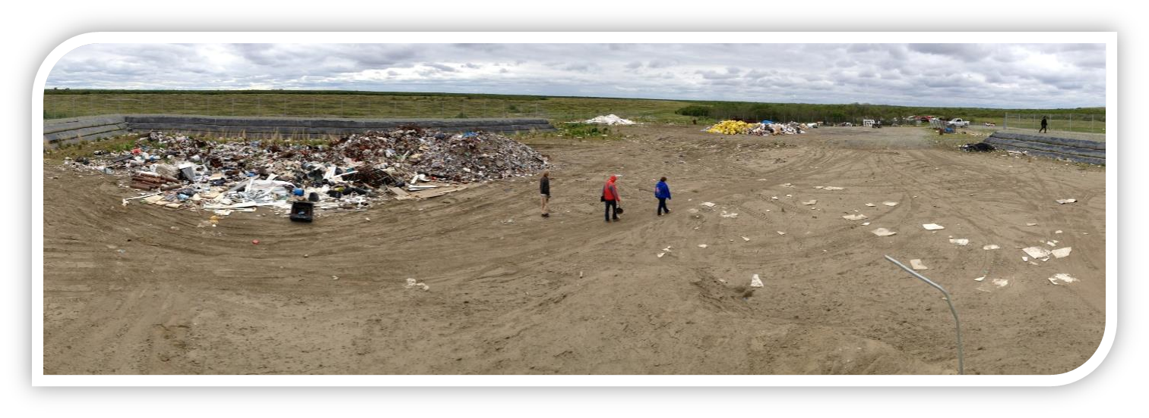
Class III Landfills-Accept less than 5 tons of waste per day
Alaska is the only state with a class III category, 86% are permitted
Designed for remote communities with limited resources, 70% of Class III landfills serve less than 250 people
All sites are state regulated and generally less than 3 acres in size
Burning of waste is allowed and no liner is required
Notes:
Alaska came up with the class III designation to address landfill management issues in small remote communities in rural Alaska.
The Class III designation was approved by act of Congress via the Land Disposal Program Flexibility Act of 1996. In brief, that law exempts these small landfills from the federal regulations and allows the state to establish appropriate regulatory standards.

Slide 7
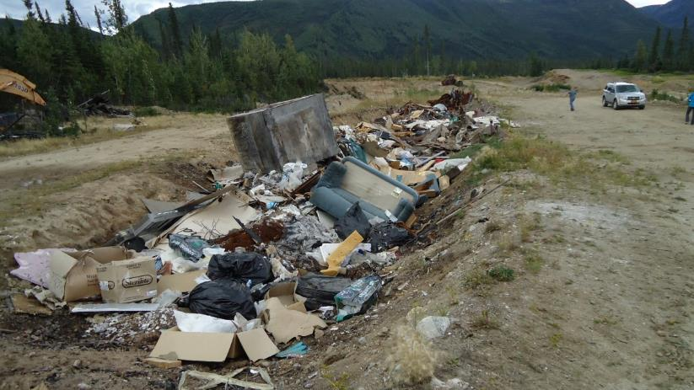
Solid Waste Program Regulations
Purpose of 18 AAC 60
Promote cost-effective, environmentally-sound solid waste management and to ensure that landfills are designed, built, and operated to minimize health and safely threats, pollution, and nuisances
Engineering not required for rural landfills but it must meet design standards and location requirements

Slide 8
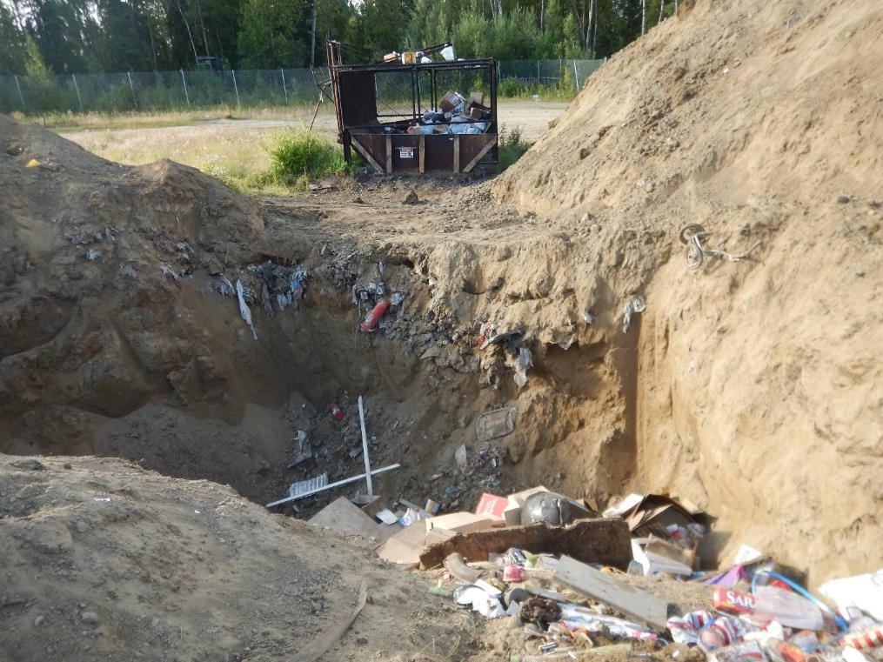
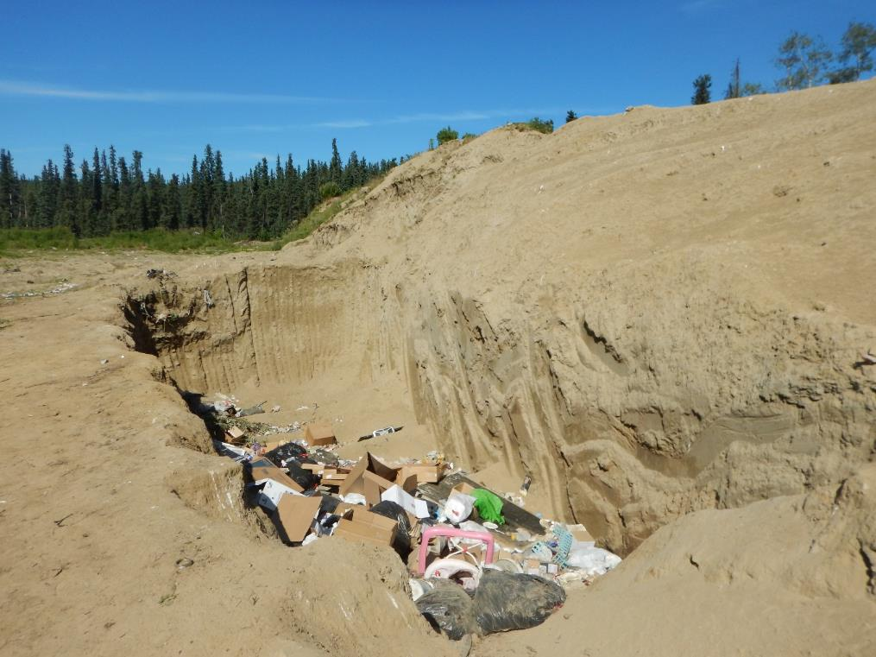
Popular Landfill Design in Rural Alaska-TRENCH AND FILL LANDFILL
Cheaper to operate and maintain
Create their own cover material
Minimize windblown litter
Final closure less expensive with the option to operate an areafill on top of filled trenches

Slide 9
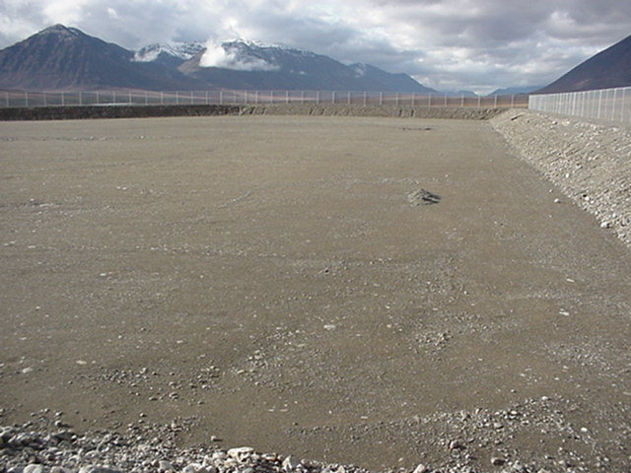
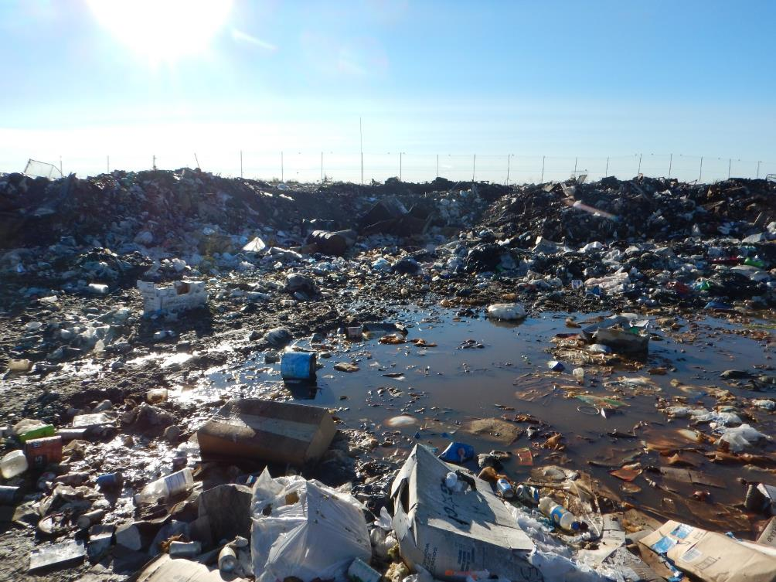
Popular Landfill Design in Rural Alaska-AREAFILL LANDFILL
Used in areas of permafrost, wetlands, or high groundwater table
Requires a 2 ft pad and berms, expensive to build and operate, require more cover material
Hard to maintain with higher potential to generate leachate
Final closure costly

Slide 10
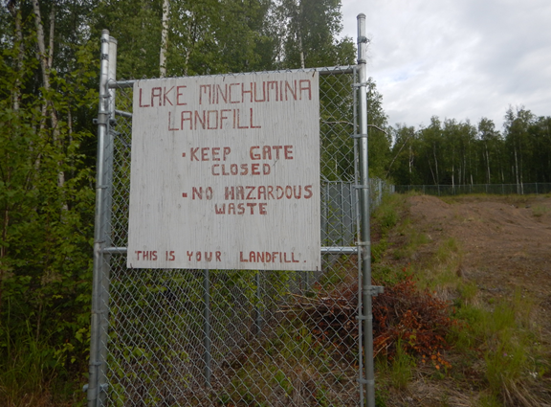
Design Standards for Rural Landfills
Must not melt out underlying permafrost
Must not adversely effect wetlands
Keeps waste out of contact with water
Provides access control via fencing or natural berms
Does not allow water to pond on site
Provides a 50ft setback from waste management area and property line of facility
Prevents dust, odor, noise, or other nuisances or hazards to public health, safety, or welfare
Minimizes animal attraction to the landfill
Does not allow landfill to impact surrounding environment

Slide 11
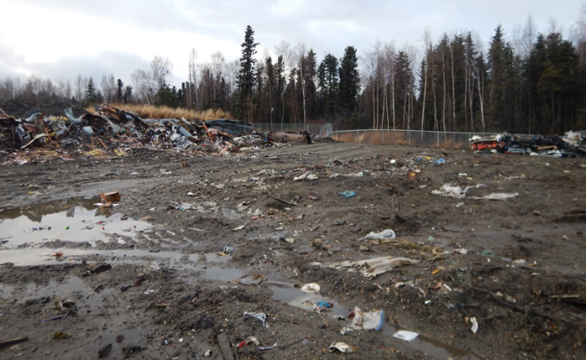
Location Requirements
Separation from Groundwater – 10 feet above GW or 2ft pad requirement
Surface Water – Amount of precipitation and storm water run-off
Permafrost – Minimum 2ft Pad Required
Airport Safety – Minimum 5000ft Distance from runway
Floodplains- Stay away or may require berms, drainages, or other controls
Wetlands-Minimum 2ft Pad Required
Fault Areas, Seismic Impact Zones and Unstable Areas-Stay away
Steep Slopes- access precipitation run off and run on
All impact design criteria and permitting

Slide 12
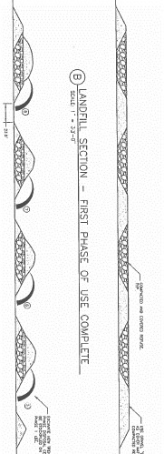
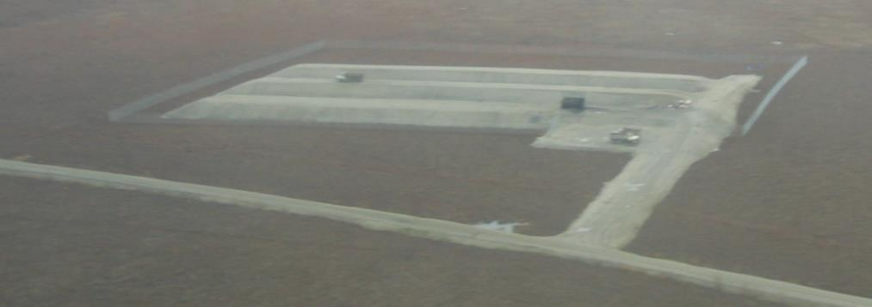
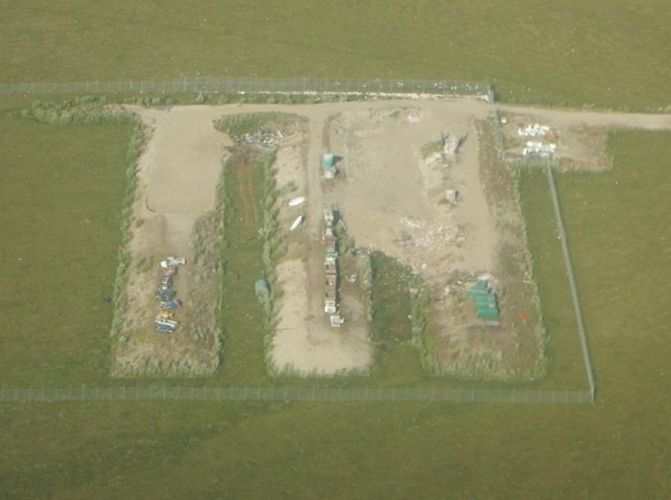
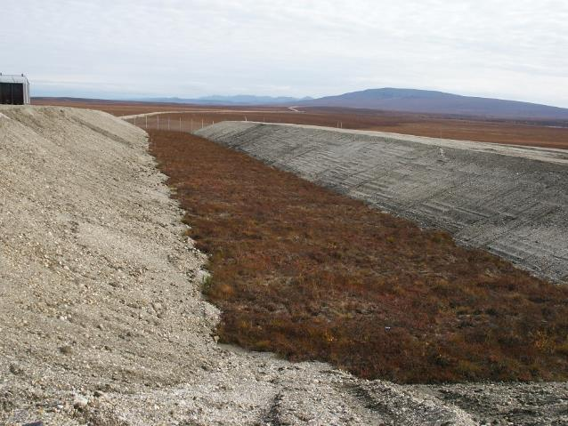
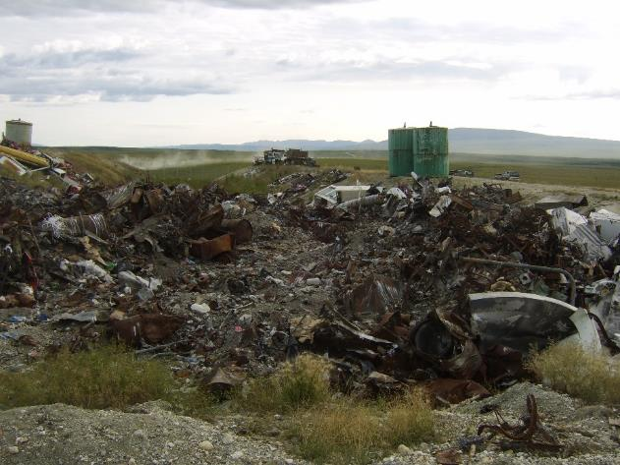
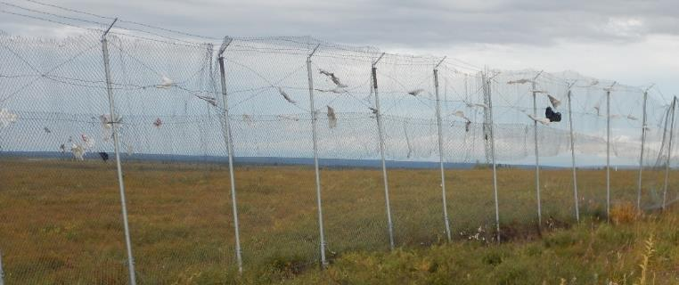
Landfill Case Study #1
Great Design!
…but too confusing to operate.

Slide 13
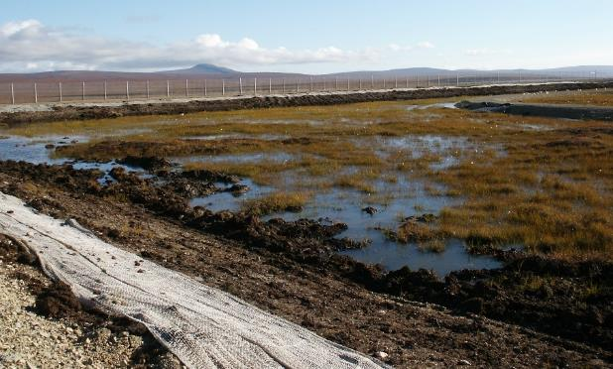
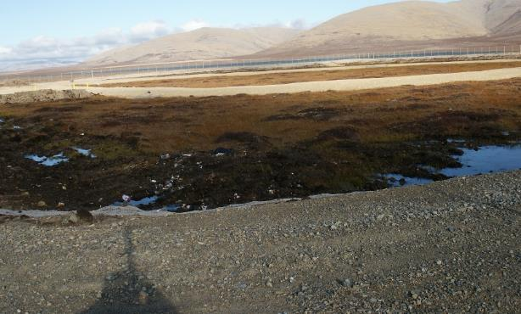
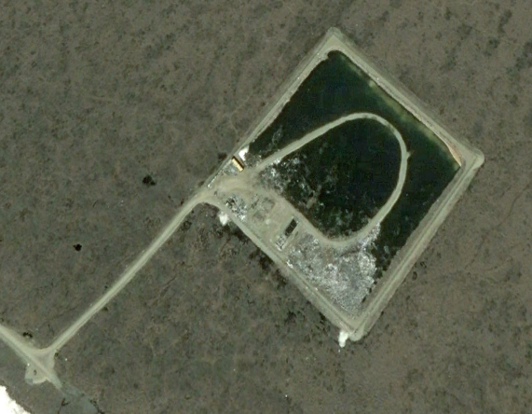
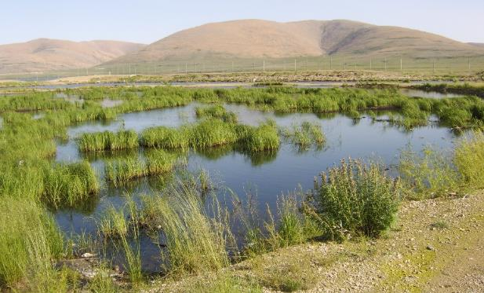
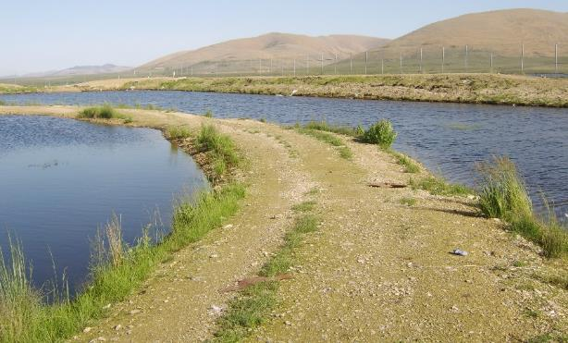
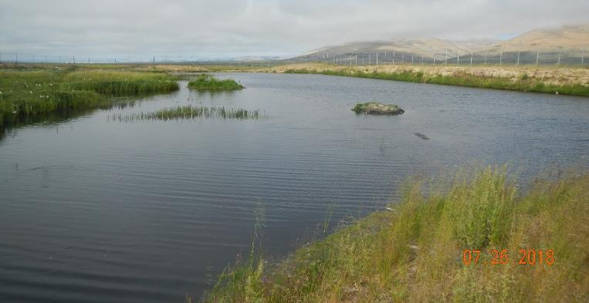
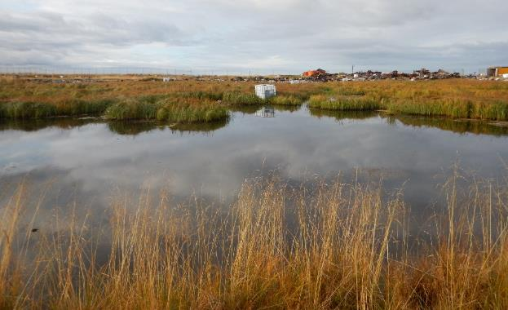
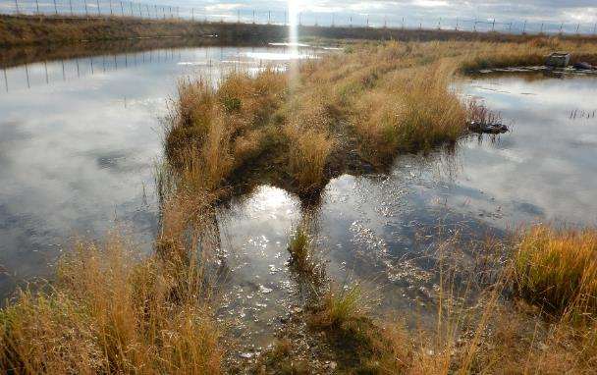
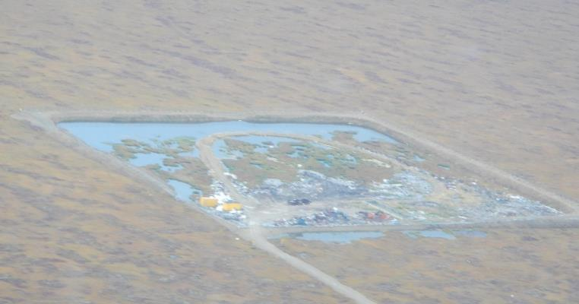
2004- Construction Complete
6/5/2007
2009
2018
Landfill Case Study #2
nonpermeable clay liner under landfill
+evapotranspiration rate calculation not realistic
=Bathtub Effect
2014
2014

Slide 14
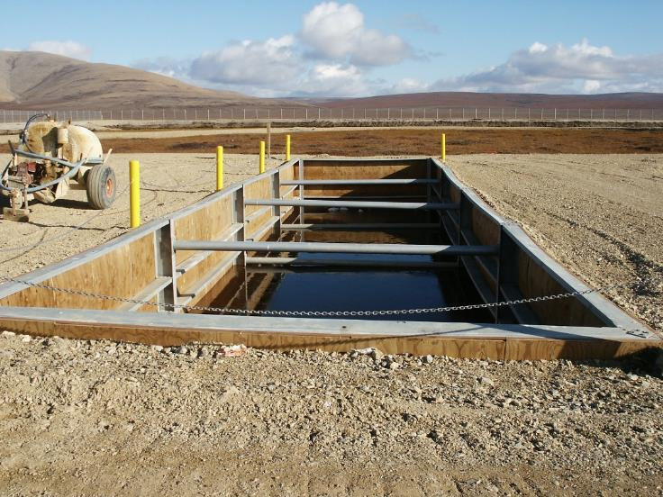
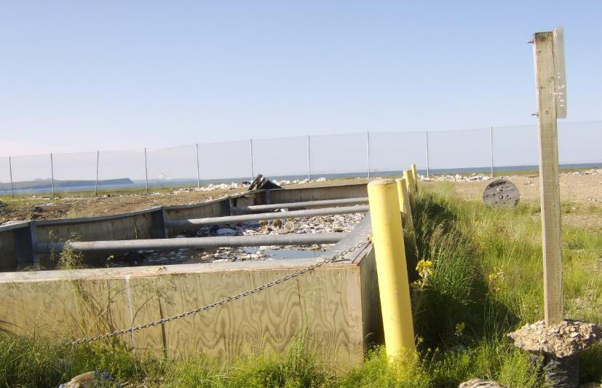
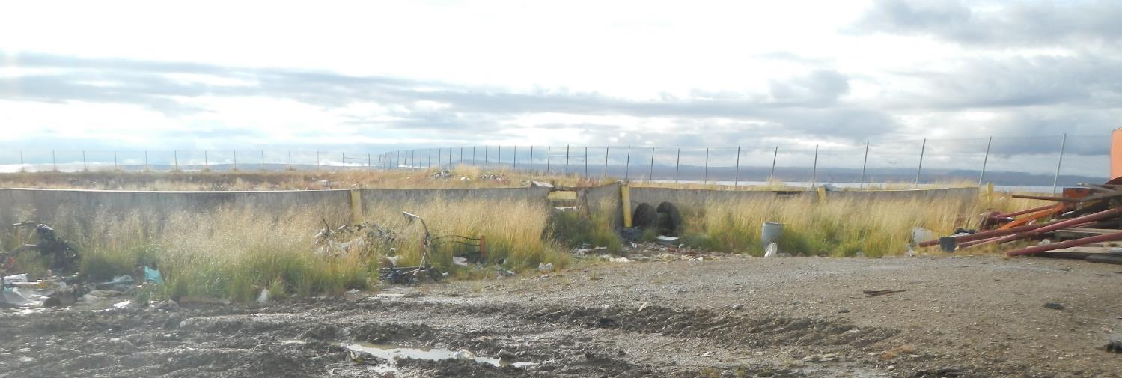
Honey Bucket Trench installed 2004
2009
2011

Slide 15
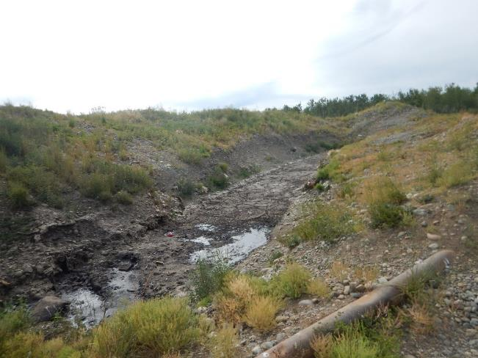
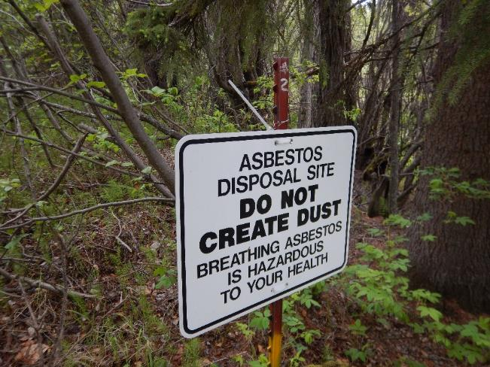
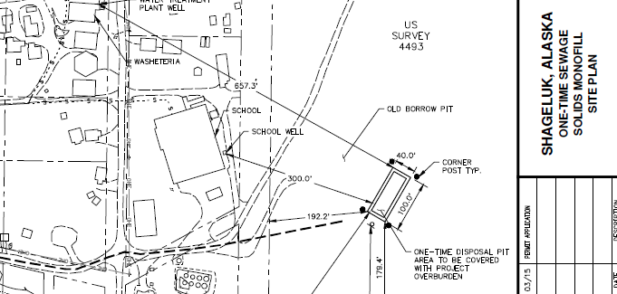
One-Time Monofill Landfills in Rural AK
Only Accept One Type of Waste
Construction and Demolition Debris
Sewage Solids
Inert Waste
Asbestos
These have the same type of design and location requirements as rural MSW landfills
Notes:
Non-MSW landfills can only receive the material for which they are permitted.
Also, MSWLFs can accept non-MSW, but a non-MSW landfill cannot accept any MSW.

Slide 16
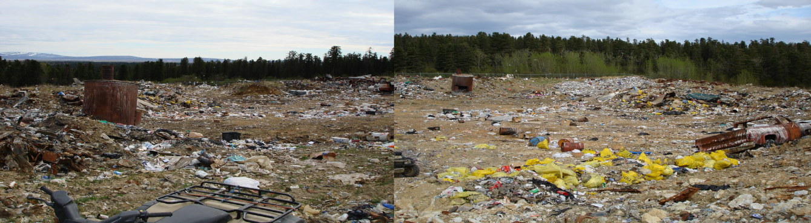
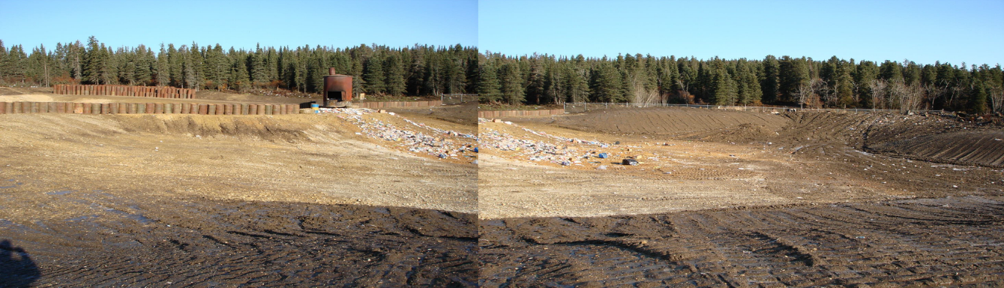
In review:
Most rural landfills are already permitted but newly constructed landfills must meet design criteria for permitting
Trench and Fill and Areafill landfills are the most common types of landfills in rural Alaska
Even rural landfills are regulated under 18 AAC 60
Check out the ADEC Solid Waste Program website to get started: https://dec.alaska.gov/eh/solid-waste for permit applications, fact sheets, contact information, regulations, and lots of other general info.
Current Trend in rural AK
Turning Unmanaged Dumps
Into Managed Landfills

